Slide 1
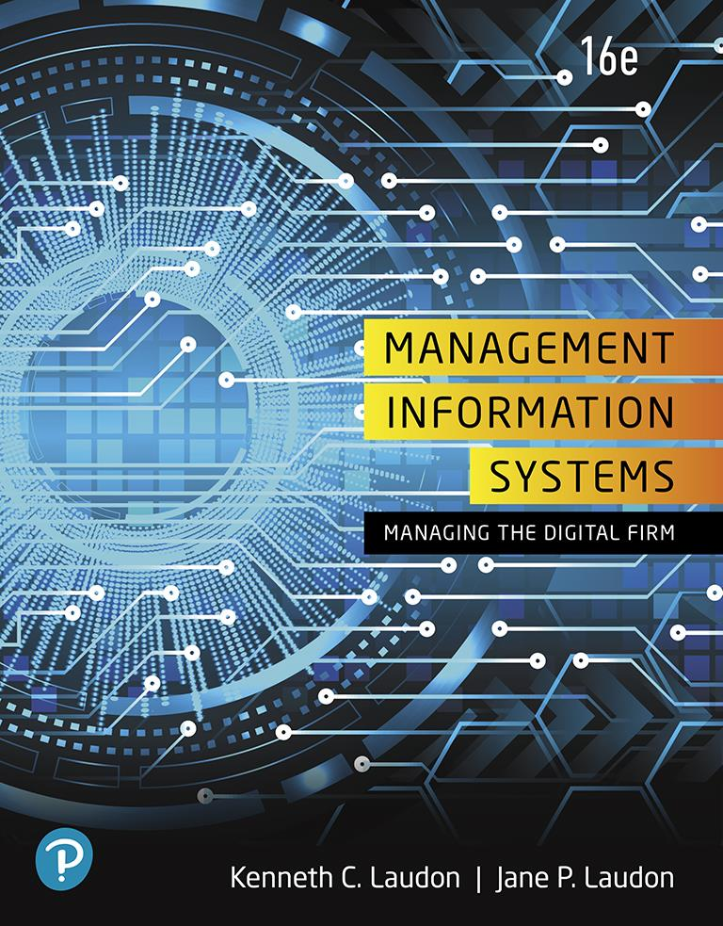
Management Information Systems: Managing the Digital Firm
Sixteenth Edition
Chapter 1
Information Systems in Global Business Today
Copyright © 2020, 2018, 2016 Pearson Education, Inc. All Rights Reserved
Notes:
If this PowerPoint presentation contains mathematical equations, you may need to check that your computer has the following installed:
1) MathType Plugin
2) Math Player (free versions available)
3) NVDA Reader (free versions available)

Slide 2
Learning Objectives
1.1 How are information systems transforming business, and why are they so essential for running and managing a business today?
1.2 What is an information system? How does it work? What are its management, organization, and technology components? Why are complementary assets essential for ensuring that information systems provide genuine value for organizations?
1.3 What academic disciplines are used to study information systems, and how does each contribute to an understanding of information systems?
1.4 How will MIS help my career?
Notes:
Students may not know exactly what is meant by globalization, or may have an incomplete understanding of the term. You might ask students what they think it means. Potential answers could include: reduction of economic and cultural advantages of developed countries, increased number of companies with operations in multiple countries worldwide, and increased reliance on imports and exports of goods (and jobs). Globalization will be discussed in later slides as well.

Slide 3
Video Cases
Case 1: Business in the Cloud: Facebook and eBay Data Centers
Case 2: U P S Global Operations with the D I A D
Instructional Video: Tour I B M’s Raleigh Data Center

Slide 4
PCL Construction: The New Digital Firm (1 of 2)
Business Challenges
Widespread operations
Paper intensive processes
Solutions
Mobile devices
Touch screen kiosks
Microsoft Azure Cloud
Virtual design and project management
Analytics dashboard

Slide 5
PCL Construction: The New Digital Firm (2 of 2)
Illustrates how information technology has changed how PCL runs its business
Demonstrates I T’s role in redesigning jobs and business processes
Illustrates the potential for technology to improve operational efficiency and customer experience

Slide 6
How Information Systems Are Transforming Business (1 of 2)
In 2017, more than 140 million businesses had dot-com addresses registered
273 million adult Americans online; 190 million purchased online
269 million Americans have mobile phones
200 million use social networks
Notes:
New federal security and accounting laws that require companies to store e-mail for 5 years have spurred the growth of digital information, which is increasing at a rate of 5 exabytes annually. Students may be surprised to learn that 5 exabytes of data is equivalent to 37,000 Libraries of Congress. Ask the students to think about what difference it makes to the world economy, or the U.S. economy, if global operations become much less expensive? What are the challenges to American suppliers of goods and services, and to labor?

Slide 7
How Information Systems Are Transforming Business (2 of 2)
Social networking tools being used by businesses to connect employees, customers, and managers
Internet advertising continues to grow at more than 20 percent per year
New laws require businesses to store more data for longer periods
Changes in business result in changes in jobs and careers
Notes:
New federal security and accounting laws that require companies to store e-mail for 5 years have spurred the growth of digital information, which is increasing at a rate of 5 exabytes annually. Students may be surprised to learn that 5 exabytes of data is equivalent to 37,000 Libraries of Congress. Ask the students to think about what difference it makes to the world economy, or the U.S. economy, if global operations become much less expensive? What are the challenges to American suppliers of goods and services, and to labor?

Slide 8
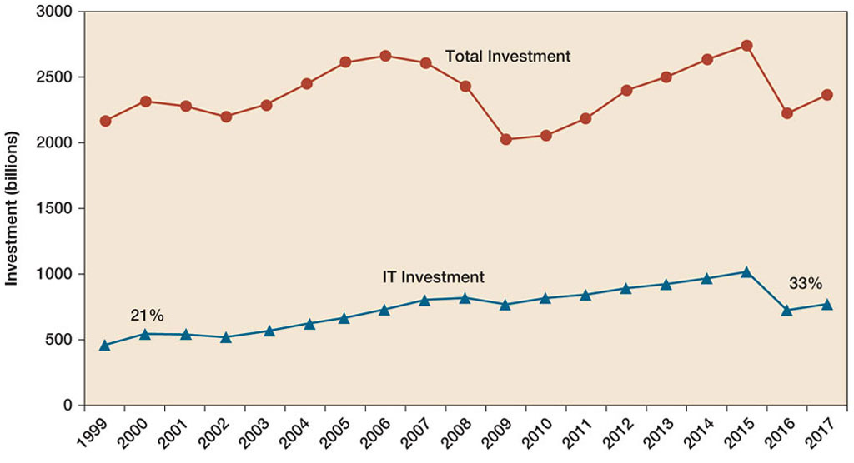
Figure 1.1 Information Technology Capital Investment
Notes:
Figure 1.1, Page 6.
Information technology capital investment, defined as hardware, software, and communications equipment, grew from 21 to 33 percent of all invested capital between 1999 and 2017.
Source: Based on data in U.S. Department of Commerce, Bureau of Economic Analysis, National Income and Product Accounts, Table 5.3.6. Real Private Fixed Investment by Type, Chained Dollars (2018).
Emphasize to students that total investment is more than 2 trillion dollars in 2017, and that more than 540 billion dollars of that was invested in information technology. You could ask them why it is that the percentage of total investment devoted to IT has increased so much since 1980. Other kinds of capital investment are machinery and buildings. Why would firms increase IT investment faster than machinery and buildings? Part of the answer is capital substitution: the price of IT capital has been falling exponentially, whereas the price of machine and buildings has been growing at slightly more than the rate of inflation. Wherever possible, firms would much rather invest in more IT than machinery or buildings because the returns on the investment are greater.
Full description: A line graph, with years 1999 to 2017 on the horizontal access and investment, 0 to 3 trillion dollars, on the vertical axis, two lines show all invested capital for U S businesses and information technology capital investment. Total invested capital grew from about 2.2 trillion dollars in 1999 to about 2.7 trillion dollars in 2006. It then declined to about 2 trillion dollars in 2009 before increasing to about 2.8 trillion dollars by 2015. It declined again to about 2.2 trillion in 2016, rising to 2.4 trillion in 2017. Total information technology capital investment grew steadily from about 500 billion dollars in 1999, which was 21 percent of total capital invested, to about 1 trillion dollars by 2015. It declined to about .6 trillion in 2016, rising slightly to about .7 trillion in 2017, or about 33 percent of total capital invested.

Slide 9
What’s New in Management Information Systems (1 of 3)
I T Innovations
Cloud computing, big data, Internet of Things
Mobile digital platform
AI and machine learning
New Business Models
Online streaming music and video
On-demand e-commerce services

Slide 10
What’s New in Management Information Systems (2 of 3)
E-commerce Expansion
E-commerce expands to nearly $1 trillion in 2018
Netflix now has more than 125 million U S subscribers
Online services now approach online retail in revenue
Online mobile advertising now larger than desktop
Management Changes
Managers use social networks, collaboration tools
Business intelligence applications accelerate
Virtual meetings proliferate

Slide 11
What’s New in Management Information Systems (3 of 3)
Firms and Organizations Change
More collaborative, less emphasis on hierarchy and structure
Greater emphasis on competencies and skills
Higher-speed/more accurate decision making based on data and analysis
More willingness to interact with consumers (social media)
Better understanding of the importance of I T

Slide 12
Interactive Session: Management: Can You Run the Company with Your iPhone? (1 of 2)
Class Discussion
What kinds of applications are described here? What business functions do they support? How do they improve operational efficiency and decision making?
Identify the problems that the business in this case study solved by using mobile digital devices.
Notes:
Ask students whether or not the smartphones that are changing business have had a similar effect on their own lives. Have iPhones dramatically changed they way they do things or created new possibilities?

Slide 13
Interactive Session: Management: Can You Run the Company with Your iPhone? (2 of 2)
Class Discussion
What kinds of businesses are most likely to benefit from equipping their employees with mobile digital devices such as iPhones and iPads?
One company deploying iPhones has stated, “The iPhone is not a game changer, it’s an industry changer. It changes the way that you can interact with your customers” and “with your suppliers.” Discuss the implications of this statement.
Notes:
Ask students whether or not the smartphones that are changing business have had a similar effect on their own lives. Have iPhones dramatically changed they way they do things or created new possibilities?

Slide 14
Globalization Challenges and Opportunities: A Flattened World (1 of 2)
Internet and global communications have greatly changed how and where business is done
Drastic reduction of costs of operating and transacting on global scale
Competition for jobs, markets, resources, ideas
Growing interdependence of global economies
Notes:
Ask your students about their experience and thoughts about globalization. What benefits and costs have they experienced in their lives?

Slide 15
Globalization Challenges and Opportunities: A Flattened World (2 of 2)
Requires new understandings of skills, markets, opportunities
Challenges yes, but opportunities as well
Over half of the revenue of S&P 500 US firms is generated off shore
Information systems enable globalization of commerce

Slide 16
The Emerging Digital Firm
In a fully digital firm:
Significant business relationships are digitally enabled and mediated
Core business processes are accomplished through digital networks
Key corporate assets are managed digitally
Digital firms offer greater flexibility in organization and management
Time shifting, space shifting
Notes:
Time shifting and space shifting are connected to globalization. You could ask students to explain why a digital firm is more likely to benefit from globalization than a traditional firm. One answer is that by allowing business to be conducted at any time (time shifting) and any place (space shifting), digital firms are ideally suited for global operations which take place in remote locations and different time zones.

Slide 17
Strategic Business Objectives of Information Systems (1 of 2)
Growing interdependence between:
Ability to use information technology
Ability to implement corporate strategies and achieve corporate goals
Notes:
When discussing the cases and Interactive Sessions throughout the book, it will be useful to ask students to explain how various information systems succeeded or failed in achieving the six strategic business objectives. You might ask the students to think about some other business objectives and think about how IT might help firms achieve them. For instance, speed to market is very important to firms introducing new products. How can IT help achieve that objective?

Slide 18
Strategic Business Objectives of Information Systems (2 of 2)
Firms invest heavily in information systems to achieve six strategic business objectives:
Operational excellence
New products, services, and business models
Customer and supplier intimacy
Improved decision making
Competitive advantage
Survival
Notes:
Ask students about their experiences with new systems being introduced into firms where they worked, and to consider what were the most important objectives in their view of the business investment in IT.

Slide 19
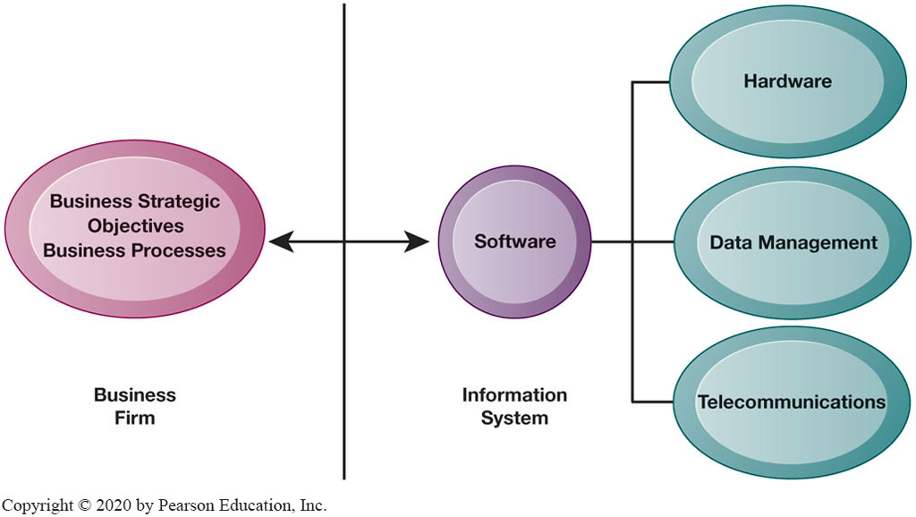
Figure 1.2 The Interdependence Between Organizations and Information Systems
Notes:
Figure 1.2, Page 13.
In contemporary systems, there is a growing interdependence between a firm’s information systems and its business capabilities. Changes in strategy, rules, and business processes increasingly require changes in hardware, software, databases, and telecommunications. Often, what the organization would like to do depends on what its systems will permit it to do.
The basic point of this graphic is that in order to achieve its business objectives, a firm will need a significant investment in IT. Going the other direction (from right to left), having a significant IT platform can lead to changes in business objectives and strategies. Emphasize the two-way nature of this relationship. Businesses rely on information systems to help them achieve their goals; a business without adequate information systems will inevitably fall short. But information systems are also products of the businesses that use them. Businesses shape their information systems and information systems shape businesses.
Full description: In the diagram, a business firm with its business strategic objectives and business processes are shown listed on the left. To the right, in the center, is the software of the information system, and further right are the firms hardware, data management, and telecommunications capabilities. Between the business firm and the information system is a vertical line dividing the two parts. A horizontal line with bidirectional arrows crosses this vertical line and connects the business strategic objectives and processes of the firm with the elements of the information system—hardware, data management, and telecommunications.

Slide 20
Operational Excellence
Improved efficiency results in higher profits
Information systems and technologies help improve efficiency and productivity
Example: Walmart
Power of combining information systems and best business practices to achieve operational efficiency—and over $485 billion in sales in 2017
Most efficient retail store in world as result of digital links between suppliers and stores
Notes:
Walmart is the most efficient retailer in the industry and exemplifies operational excellence. You could ask students to name other businesses that they believe exhibit a high level of operational excellence. Do customers perceive operational excellence? Does it make a difference for customer purchasing? What websites strike students as really excellent in terms of customer service? If you have a podium computer, you might want to visit the Walmart site and the Amazon site to compare them in terms of ease of use.

Slide 21
New Products, Services, and Business Models
Information systems and technologies enable firms to create new products, services, and business models
Business model: how a company produces, delivers, and sells its products and services
Example: Apple
Transformed old model of music distribution with iTunes
Constant innovations—iPod, iPhone, iPad, etc.
Notes:
You could ask students to name other new products or business models that they’ve encountered and how they might relate to new information systems or new technology. One way to encourage participation is ask students to help you list on the blackboard some really interesting recent digital product innovations. Discussing “green technologies” such as wind, solar, and hybrid or electric vehicles is always fun. Autonomous vehicles are soon to come in the next five years. In this context, what role will IT be playing in the development of these technologies?

Slide 22
Customer and Supplier Intimacy
Customers who are served well become repeat customers who purchase more
Example: Mandarin Oriental Hotel
Uses I T to foster an intimate relationship with its customers, keeping track of preferences, etc.
Close relationships with suppliers result in lower costs
Examples: Mandarin Oriental Hotel and J C Penney (in text)
J C Penney uses I T to enhance relationship with supplier in Hong Kong
Notes:
You could ask students what types of companies might rely more on customer and supplier intimacy more than others and which companies they feel have served them exceptionally well. Ask the students to identify online sites that achieve a high degree of customer intimacy. Sites to visit would include Netflix, Amazon, and other sites which have recommender systems to suggest purchase ideas to consumers.

Slide 23
Improved Decision Making (1 of 2)
Without accurate information:
Managers must use forecasts, best guesses, luck
Results in:
Overproduction, underproduction
Misallocation of resources
Poor response times
Notes:
You could ask students if they have ever been recipients of exceptional service from a company made possible by improved decision making and whether or not information systems contributed to that level of service. For example, perhaps they had a power outage and it took a very short (or very long) time for the utility company to correct the error.

Slide 24
Improved Decision Making (2 of 2)
Poor outcomes raise costs, lose customers
Real-time data improves ability of managers to make decisions.
Example: Verizon’s web-based digital dashboard to provide managers with real-time data on customer complaints, network performance, line outages, etc.
Notes:
You could ask students if they have ever been recipients of exceptional service from a company made possible by improved decision making and whether or not information systems contributed to that level of service. For example, perhaps they had a power outage and it took a very short (or very long) time for the utility company to correct the error.

Slide 25
Competitive Advantage
Often results from achieving previous business objectives
Advantages over competitors
Charging less for superior products, better performance, and better response to suppliers and customers
Examples: Apple, Walmart, U P S are industry leaders because they know how to use information systems for this purpose
Notes:
Emphasize that achieving any of the previous four business objectives represents the achievement of a competitive advantage as well.

Slide 26
Survival
Businesses may need to invest in information systems out of necessity; simply the cost of doing business
Keeping up with competitors
Citibank’s introduction of A T Ms
Federal and state regulations and reporting requirements
Toxic Substances Control Act and the Sarbanes-Oxley Act
Notes:
Ask students if they can name any examples of companies that failed to survive due to unwillingness or inability to update their information systems. The Sarbanes-Oxley Act (2002) requires that public firms keep all data, including e-mail, on record for 5 years. The Dodd-Frank Act (2010) requires financial services firms to develop extensive new compliance reports. You could ask students if they appreciate why information systems would be useful toward meeting the standards imposed by these new federal statutes.

Slide 27
What Is an Information System? (1 of 3)
Information technology: the hardware and software a business uses to achieve objectives
Information system: interrelated components that manage information to:
Support decision making and control
Help with analysis, visualization, and product creation
Data: streams of raw facts
Information: data shaped into meaningful, useful form
Notes:
These is some basic background understanding needed for the course. A system refers to a set of components that work together (hopefully). Can students think of systems other than information systems? The point of an information system is to make sense out all the confusing data in the environment, and put the data into some kind of order. Information is an ordered set of data that you can understand and act on. If the students want to get a sense of raw data, show them a stock ticker on a financial website, such as Yahoo/finance. Ask them to tell you what it means? Then show them the current value of the Dow Jones Industrial Index and the S&P 500, and its daily trend (or for that matter switch to a one year view of either of these indexes). Looking at the indexes students can quickly get a grasp of whether the market is up or down, and they could act on that information.

Slide 28
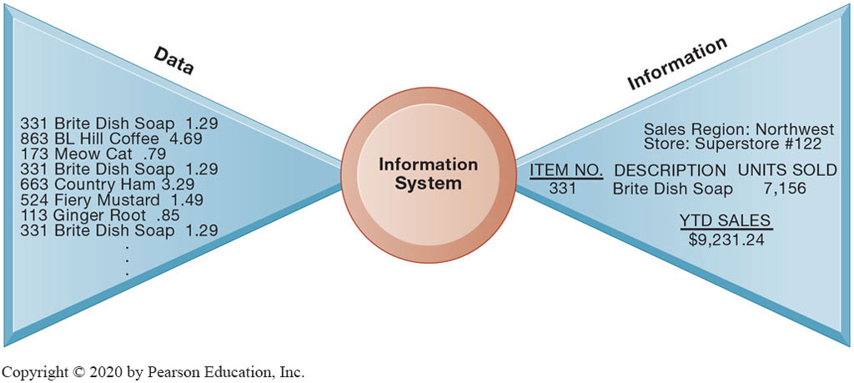
Figure 1.3 Data and Information
Notes:
Figure 1.3, Page 17.
Raw data from a supermarket checkout counter can be processed and organized to produce meaningful information, such as the total unit sales of dish detergent or the total sales revenue from dish detergent for a specific store or sales territory.
Emphasize the distinction between information and data. You could, for example, ask several students to list their ages and write the numbers on one side of the board—then you could calculate the average age of those students on the other side, oldest student, youngest student, and so forth, to illustrate the difference between raw data and meaningful information.
Full description: The diagram depicts the input to information systems. Data shown here that flow into information systems include item number, item description, and item price at a supermarket checkout. These data are organized into meaningful information such as item units sold, year-to-date sales, and location of sales.

Slide 29
What Is an Information System? (2 of 3)
Activities in an information system that produce information:
Input
Processing
Output
Feedback
Sharp distinction between computer or computer program versus information system
Notes:
Use an example similar to the one given in the previous slide to illustrate the three activities involved in the function of an information system. Continuing with that example, the process of asking students their age would represent input, calculating the average age and determining the oldest and youngest age would represent processing, and writing that information on the board would represent output.

Slide 30
What is an Information System? (3 of 3)
Feedback
Output is returned to appropriate members of organization to help evaluate or correct input stage
Computer/computer program vs. information system
Computers and software are technical foundation and tools, similar to the material and tools used to build a house
Notes:
Explain to students how the “house” analogy works: assuming that a successful information system is like a completed “house,” computers and software represent only the tools and materials used to build the house. Tools and materials don’t just suddenly become a completed house—outside (human) input is required. Systems need to be designed to fit the firms and the humans who work with the systems.

Slide 31
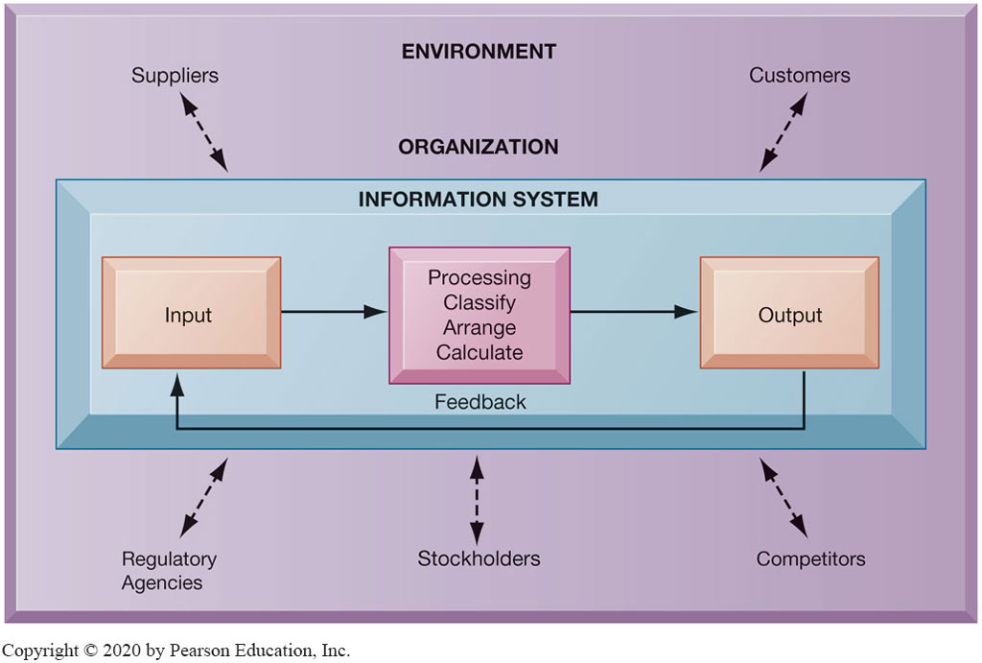
Figure 1.4 Functions of an Information System
Notes:
Figure 1.4, Page 18.
An information system contains information about an organization and its surrounding environment. Three basic activities—input, processing, and output—produce the information organizations need. Feedback is output returned to appropriate people or activities in the organization to evaluate and refine the input. Environmental actors, such as customers, suppliers, competitors, stockholders, and regulatory agencies, interact with the organization and its information systems.
The point of this diagram is first of all to highlight the three basic activities of information systems, so that students can understand what an information system is doing at its most fundamental level. But the diagram also puts information systems into the context of organizations (firms), and then puts the firm into its respective environment composed of shareholders, higher level authorities (government), competitors, suppliers, and customers. Suddenly, students should see that information systems play a central role mediating and interacting with all these players. Hence, systems play a key role in the operations and survival of the firm.
You could also explain this diagram by relating it back to the opening case, as the book does. The two types of input into the Synergy system are manually entered data as well as video. The system processes that data and creates the output, video, and statistics about specific types of players and plays.
Full description: The diagram depicts the three activities of an information system within an organization. The activities are listed as follows. 1, Input. 2, Processing, including classify, arrange, calculate. 3, Output. These activities form a loop as feedback that follows output leads to the input at the beginning of the cycle. The activities of an organization’s information system take place within the business’s environment, which is influenced by numerous factors, including Suppliers, Customers, Regulatory agencies, Stockholders, and Competitors.

Slide 32
Dimensions of Information Systems
Organizations
Management
Technology

Slide 33
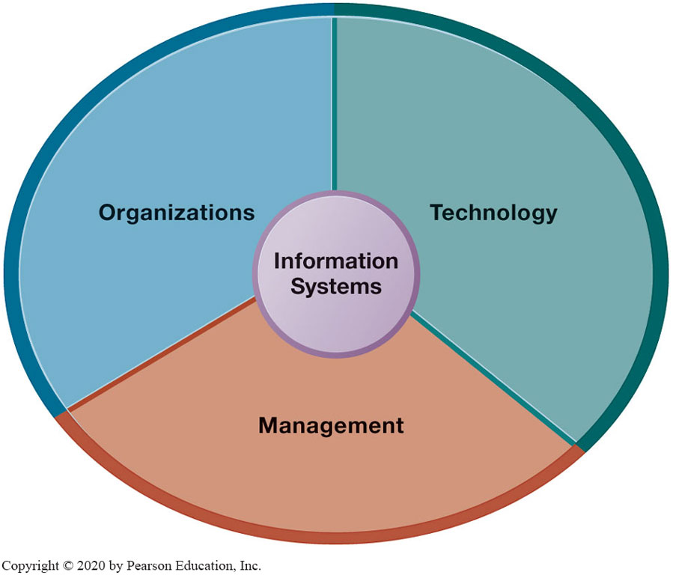
Figure 1.5 Information Systems Are More Than Computers
Notes:
Figure 1.5, Page 19.
Using information systems effectively requires an understanding of the organization, management, and information technology shaping the systems. An information system creates value for the firm as an organizational and management solution to challenges posed by the environment.
These three themes (management, organizations, and technology) will reappear throughout the book. Understanding the interaction among these factors and information systems is known as information system literacy. Knowing how to optimize the relationship between technology, organizations, and management is the purpose of this book and course.

Slide 34
Dimensions of Information Systems: Organizations (1 of 2)
Hierarchy of authority, responsibility
Senior management
Middle management
Operational management
Knowledge workers
Data workers
Production or service workers
Notes:
Pages 18 and 19 in the text provide more specific details on each level of this hierarchy. You can ask students to talk about an organization where they currently work, or have worked in the past. What was their contact with senior management, middle management, and operational (supervisory) management? Many younger students will have had little or no contact with senior and middle management. Older students most likely will have experience. You might need to provide more description about exactly what senior managers do for the firm (and middle managers).

Slide 35
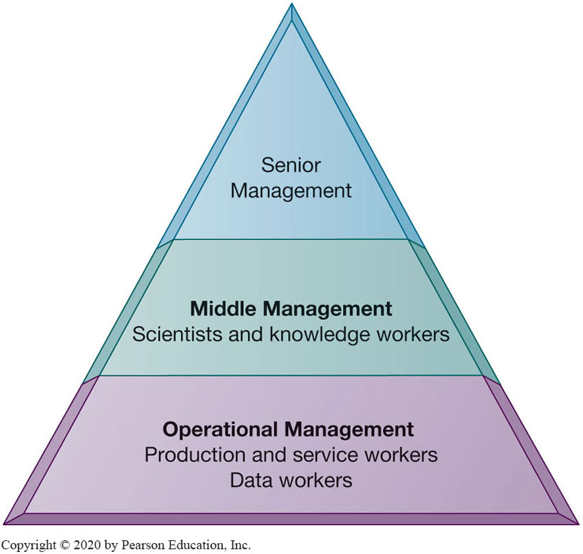
Figure 1.6 Levels in a Firm
Notes:
Figure 1.6, Page 20.
Business organizations are hierarchies consisting of three principal levels: senior management, middle management, and operational management. Information systems serve each of these levels. Scientists and knowledge workers often work with middle management.
Ask students to think about how information systems would factor into the day-to-day jobs of each of the three types of workers in the pyramid.
Full description: A pyramid diagram depicts the hierarchy of a business organization. At the bottom level of the pyramid organizational hierarchy is Operational Management, which consists of production and service workers and data workers. Above it in the middle level is Middle Management, made up of scientists and knowledge workers. At the top of the pyramid is Senior Management.

Slide 36
Dimensions of Information Systems: Organizations (2 of 2)
Separation of business functions
Sales and marketing
Human resources
Finance and accounting
Manufacturing and production
Unique business processes
Unique business culture
Organizational politics
Notes:
The point of this slide is to let students know there are many organizational factors that will shape information systems. A common observation is that “Every business is different.” Does this mean every business will have different information systems? Every business has its unique culture and politics. Systems reflect these business cultures.
For an example of how information systems shed light on a firm’s unique business processes and culture, you might describe the UPS Interactive Session later in the chapter. The company’s package tracking systems exemplify their commitment to customer service and putting the customer first.

Slide 37
Dimensions of Information Systems: Management
Managers set organizational strategy for responding to business challenges
In addition, managers must act creatively
Creation of new products and services
Occasionally re-creating the organization
Notes:
How might information systems assist managers in the development of new products and services? What is meant by re-creating the organization? Why do organizations need to be continually re-created? The answer is that they quickly become obsolete unless they continue to change. Ask students to help you list some organizations that have recently failed, or are about to fail.

Slide 38
Dimensions of Information Systems: Technology
Computer hardware and software
Data management technology
Networking and telecommunications technology
Networks, the Internet, intranets and extranets, World Wide Web
I T infrastructure: provides platform that system is built on
Notes:
Information technology is at the heart of information systems. Although organization and management are important too, it’s the technology that enables the systems and the organizations and managers who use the technology.
The distinction between the Internet and intranets and extranets has to do with their scope. Intranets are private networks used by corporations and extranets are similar except that they are directed at external users (such as customers and suppliers). In contrast, the Internet connects millions of different networks across the globe. Students may not immediately understand this distinction.

Slide 39
Interactive Session: Technology: U P S Competes Globally with Information Technology
Class Discussion
What are the inputs, processing, and outputs of U P S’s package tracking system?
What technologies are used by U P S? How are these technologies related to U P S’s business strategy?
What strategic business objectives do U P S’s information systems address?
What would happen if U P S’s information systems were not available?
Notes:
UPS is a good example of a company that successfully uses information systems to enhance their business.
Discuss the Delivery Information Acquisition Device (DIAD) and its various uses. Why is it an excellent example of an information system affected by a firm’s business and vice versa? Do students think UPS does a good job with its information systems? What might they improve?

Slide 40
Dimensions of U P S Tracking System
Organizational
Procedures for tracking packages and managing inventory and provide information
Management
Monitoring service levels and costs
Technology
Handheld computers, bar-code scanners, networks, desktop computers, and so on
Notes:
Discuss what the consequences would be if any one of the three dimensions of information systems were lacking at UPS. With poor technology, good management and organizational procedures would not significantly increase efficiency; without good organizational procedures, even the highest-quality technology wouldn’t prevent frequent errors and data loss; and without good management, the company would not make appropriate decisions about how to use the technology and what procedures to use.

Slide 41
It Isn’t Just Technology: A Business Perspective on Information Systems (1 of 3)
Information system is instrument for creating value
Investments in information technology will result in superior returns
Productivity increases
Revenue increases
Superior long-term strategic positioning
Notes:
You could ask students to consider how this view of information systems might contrast with the sociotechnical view or other views. You could also ask them to consider the circumstances under which information systems might not result in increased productivity and revenue.

Slide 42
It Isn’t Just Technology: A Business Perspective on Information Systems (2 of 3)
Business information value chain
Raw data acquired and transformed through stages that add value to that information
Value of information system determined in part by extent to which it leads to better decisions, greater efficiency, and higher profits
Business perspective
Calls attention to organizational and managerial nature of information systems
Notes:
During this and the next slide, emphasize that the end result of the business information value chain will always be profitability.
Questions for students: What aspects of the business perspective might be lacking? Are there other perspectives that might provide a different picture? (sociotechnical)

Slide 43
It Isn’t Just Technology: A Business Perspective on Information Systems (3 of 3)
Investing in information technology does not guarantee good returns
There is considerable variation in the returns firms receive from systems investments
Factors
Adopting the right business model
Investing in complementary assets (organizational and management capital)
Notes:
Connect this slide to the previous slide. Many firms make significant investments in IT for very little benefit to the bottom line. Discuss why companies experience a wide variety of outcomes in their efforts to invest in IT. Consider the factors we use in this book: organizational and management factors.

Slide 44
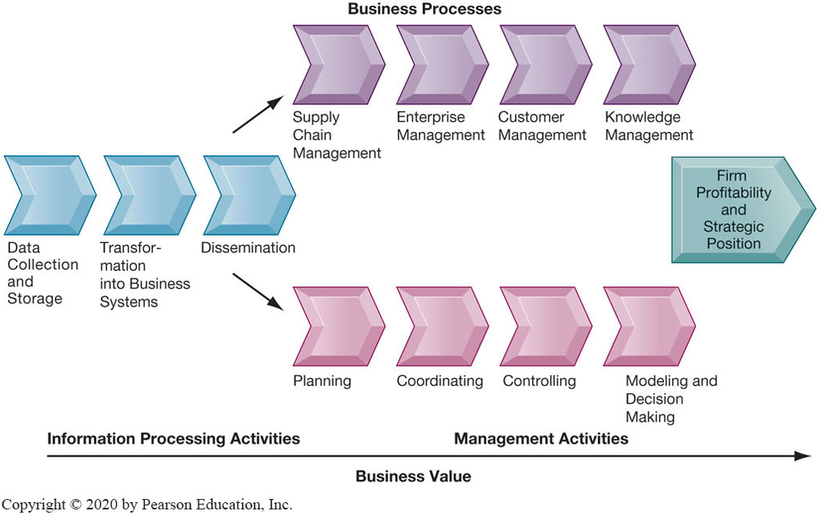
Figure 1.7 The Business Information Value Chain
Notes:
Figure 1.7, Page 25.
From a business perspective, information systems are part of a series of value-adding activities for acquiring, transforming, and distributing information that managers can use to improve decision making, enhance organizational performance, and, ultimately, increase firm profitability.
The information value chain is one way to visualize the relationship among information activities, business processes, and management activities. You could also ask students if they could imagine any reason to create an information system besides profitability or strategic positioning (it’s not likely that they will think of one, which will prove the point). One reason to create a system that is not primarily profit-oriented is to meet the information reporting requirements of government and other authorities.
Full description: A diagram depicts the components of a business information value chain. In the diagram, information processing activities are labeled as follows. Data collection and storage. Transformation into business systems. Dissemination. This dissemination flows into two areas, with increases in business value along the way. The first of the areas is, Business Processes, which includes the following items. Supply chain management. Enterprise management. Customer management. Knowledge management. The other area is Management Activities, which includes the following items. Planning, Coordinating, Controlling, Modeling and Decision making. The result of all these value adding activities is firm profitability and strategic position.

Slide 45
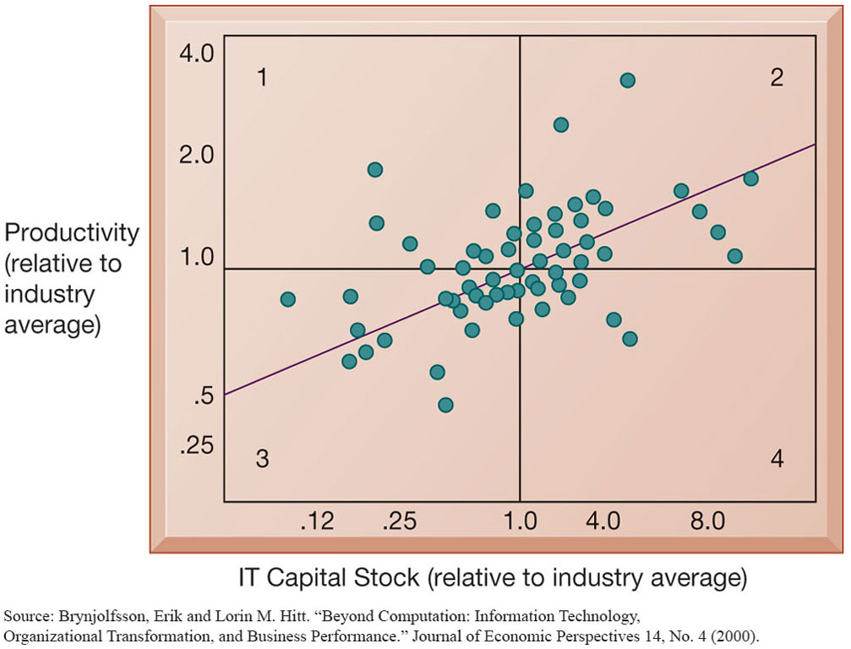
Figure 1.8 Variation in Returns on Information Technology
Notes:
Figure 1.8, Page 26.
Although, on average, investments in information technology produce returns far above those returned by other investments, there is considerable variation across firms.
Source: Brynjolfsson, Erik and Lorin M. Hitt. “Beyond Computation: Information Technology, Organizational Transformation, and Business Performance.” Journal of Economic Perspectives 14, No. 4 (2000).
Emphasize that each quadrant of the graph represents a different type of firm.
Quadrant 1 represents firms that invest much less in IT but still receive strong returns.
Quadrant 2 represents firms that invest a great deal in IT and receive a great deal in returns.
Quadrant 3 represents firms that invest much less in IT and receive poor returns.
Quadrant 4 represents firms that invest a great deal in IT but receive poor returns.
Ask students where they want their firms to show up? The purpose of the course and book is to show students how to end up in top quadrant (2).
Full description: In the scatter diagram, I T capital stock is indicated on the horizontal axis and productivity is plotted on the vertical axis. Both variables are noted relative to industry averages. Most of the data points are found near the center of the graph, reflecting the ratio between I T capital stock and productivity is one to one. The trend line fitted to the data points shows the relationship to trend to be upward sloping.

Slide 46
Complementary Assets: Organizational Capital and the Right Business Model (1 of 2)
Assets required to derive value from a primary investment
Firms supporting technology investments with investment in complementary assets receive superior returns
Example: Invest in technology and the people to make it work properly
Notes:
The example used in the book for complementary assets is for automobile companies: these companies rely on investments in highways, other roads, gas stations, repair facilities, and so on to maximize the value of their primary investment. Ask students to provide a different example of another company’s or industries complementary assets.

Slide 47
Complementary Assets: Organizational Capital and the Right Business Model (2 of 2)
Complementary assets
Examples of organizational assets
Appropriate business model
Efficient business processes
Examples of managerial assets
Incentives for management innovation
Teamwork and collaborative work environments
Examples of social assets
The Internet and telecommunications infrastructure
Technology standards
Notes:
Emphasize that firms that make significant investment in complementary assets tend to derive greater benefit from information technology investment than those that do not. Consideration of complementary assets should be a part of any firm’s broader view of how to create and implement their information systems. Stress to students that managers must consider dimensions such as complementary assets in order to derive benefit from information systems and be successful.

Slide 48
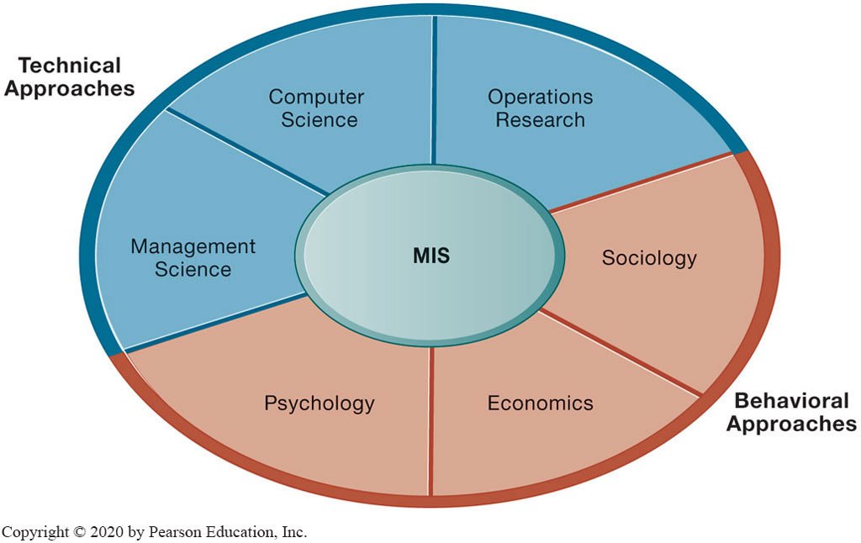
Figure 1.9 Contemporary Approaches to Information Systems
Notes:
Figure 1.9, Page 28.
The study of information systems deals with issues and insights contributed from technical and behavioral disciplines.
Ask students which of the two major types of approaches, behavioral and technical, they find to be most appropriate or accurate. Why do they feel this way? Emphasize that the technical approach does not ignore behavior and the behavioral approach does not ignore technology, but that they are indeed two distinct approaches.
Full description: A diagram depicts the technical and behavioral approaches taken to information systems. At the center of the diagram are management information systems. One half of the circle surrounding the M I S are the technical approaches of management science, computer science, and operations research. The other half of the circle consists of behavioral approaches, which include economics, sociology, and psychology.

Slide 49
Technical Approach
Emphasizes mathematically based models
Computer science, management science, operations research
Notes:
You might ask the students whether they think it’s possible to adopt only one of the two approaches to information systems and be successful. Then emphasize that the most accurate position is that there is no single approach that can truly capture the full scope and importance of information systems by itself.

Slide 50
Behavioral Approach
Behavioral issues (strategic business integration, implementation, etc.)
Psychology, economics, sociology

Slide 51
Approach of This Text: Sociotechnical Systems (1 of 2)
Management information systems
Combine computer science, management science, operations research, and practical orientation with behavioral issues
Four main actors
Suppliers of hardware and software
Business firms
Managers and employees
Firm’s environment (legal, social, cultural context)
Notes:
Ask students to describe some of the relationships between the four main actors. For example, business firms look to acquire the components of their information systems from suppliers of hardware and software. The firm’s environment may dictate the type of software a company uses as well as the kind of employees that work there.

Slide 52
Approach of This Text: Sociotechnical Systems (2 of 2)
Sociotechnical view
Optimal organizational performance achieved by jointly optimizing both social and technical systems used in production
Helps avoid purely technological approach
Notes:
The sociotechnical systems perspective was also discussed briefly in slide 3, which you could revisit to give students a refresher. The critical aspect of this view is the balance between technological and social/behavioral concerns. Sometimes a lesser form of technology may be the best option because it is more suited to the personal needs of the individual, for example.

Slide 53
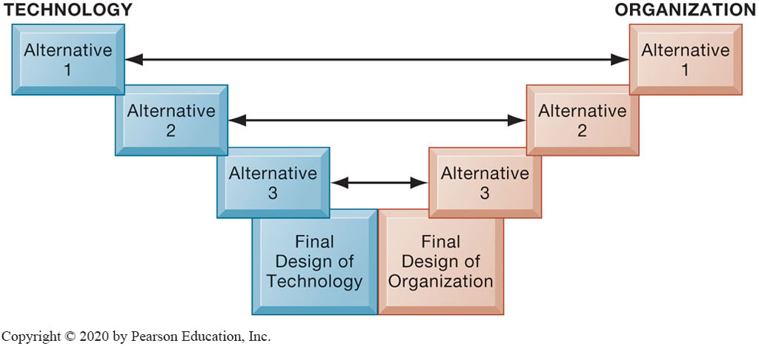
Figure 1.10 A Sociotechnical Perspective on Information Systems
Notes:
Figure 1.10, page 31.
In a sociotechnical perspective, the performance of a system is optimized when both the technology and the organization mutually adjust to one another until a satisfactory fit is obtained.
This graphic illustrates the interplay between technology and the organization. The two continue to grow closer together until an approach satisfying both perspectives is reached. Ensure that students understand that the two sides do not always need to form an equal compromise. Sometimes highly advanced technology may be more acceptable than at other times. As they will see with packaged software solutions and enterprise systems, firms are often required to change greatly in order to make the software applications work.
Full description: A diagram depicts a matchup of alternatives in a sociotechnical perspective on information systems. In the diagram, the final design of technology presents three alternatives. The final design of organization also presents three alternatives. Performance of an information system occurs within Alternative 1 for technology matches up with Alternative 1 for organization, Alternative 2 for technology matches up with Alternative 2 for organization, and Alternative 3 for technology matches up with Alternative 3 for organization.

Slide 54
How Will MIS Help My Career?
The Company: Power Financial Analytics Data Services
Position: Financial client support and sales assistant
Job Requirements
Interview Questions
Author Tips

Slide 55

Copyright
This work is protected by United States copyright laws and is provided solely for the use of instructors in teaching their courses and assessing student learning. Dissemination or sale of any part of this work (including on the World Wide Web) will destroy the integrity of the work and is not permitted. The work and materials from it should never be made available to students except by instructors using the accompanying text in their classes. All recipients of this work are expected to abide by these restrictions and to honor the intended pedagogical purposes and the needs of other instructors who rely on these materials.

